Slide 1
Containerization via cgroups and namespaces
Danilo Pejović

Slide 2
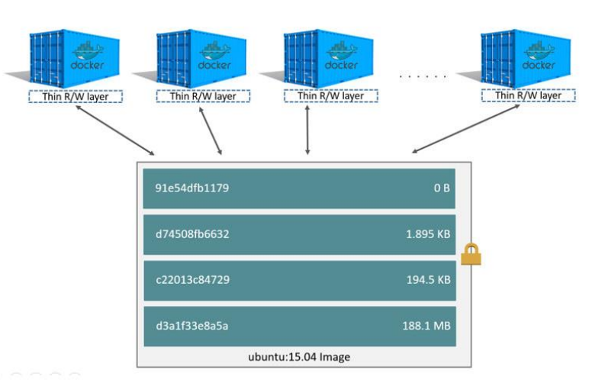
Motivation
Engineers and programmers being unfamiliar with tools they use on processes that deal with sensitive data is one of the biggest security threats.
Not understanding python virtual environments and copy-on-write led me to wasting my time
Copy-on-write adds a thin writeable layer on top of the currently active layer, every layer not in use is read-only. Makes it easy to transfer images and takes up less space.
That process is one of the biggest reasons docker has spread so much.
Process has significant drawbacks that should be kept in mind. For example, it is bad with databases.

Slide 3
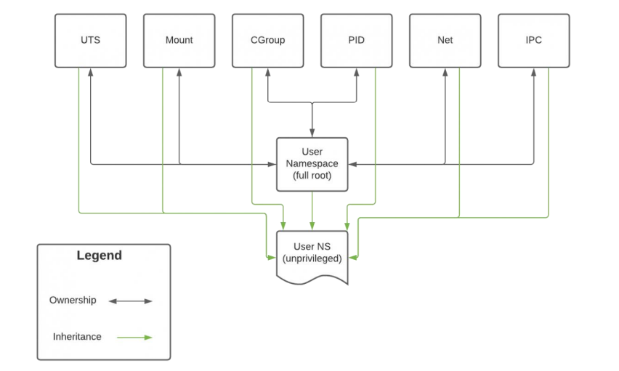
Namespaces
Isolations of processes within the Linux kernel.
Docker creates set of namespaces for containers
Created by system calls: clone; unshare and setns being most common
UTS (Unix Time Sharing) allows for separate hostnames.
Inter process communication allows safe exchange of data between processes – enables functionalities like semaphors.

Slide 4

Mount namespace
First namespace created and was called just namespace as creators didn’t think need would arise for other ones.
Mounting is act of associating filesystem or device with a place in directory tree.
Goal is to limit what files can each process see.
-Allows file systems of different types to exists next to each other
- While it can for a brief time “hide” files from root user; root user is able to track all files by folders associated with PID of the process that spawned them. This works for docker containers too and it is highly volatile way to change files inside the container

Slide 5
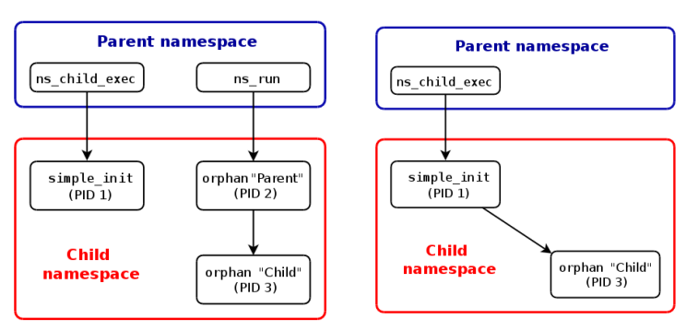
PID namespace
PID identifies the process.
PID separates number space. Two processes can have same PID if they are not in same namespace
Integral for mobility of containers between systems.
Process with PID 1 is init process of a namespace. When init is ended kernels ends all processes in namespace.
Child belongs to same namespace as parent; if orphaned init becomes parent.

Slide 6
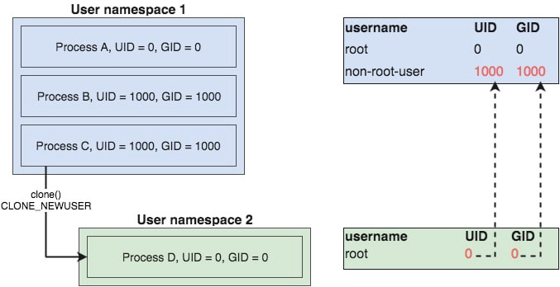
User namespace
Separates permissions for isolated processes.
Until ~5 years ago docker did not employ this type of namespace by default – leading to a security threat.
Breaking out of container where you were root doesn’t mean you are root on host.
UID governs all namespaces – all capabilities are dependent on capabilities of owner namespace.
Generally UID that are higher than 1000 indicate unprivileged user.

Slide 7
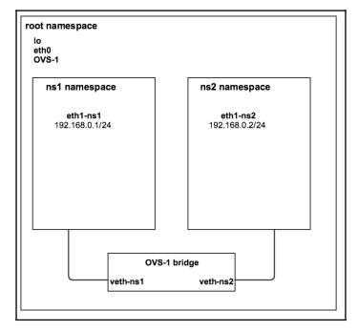
Network namespace
- Network namespaces provide isolation of the networking resources – allowing multiple processes to listen on the same port, as long as they don’t share a network namespace
Integral for mobility of docker containers; don’t have to remap the ports
Allows us to keep processes that communicate often on same namespace and separate them from others (DB and web app).
Detailed installation of network namespace in the report.

Slide 8
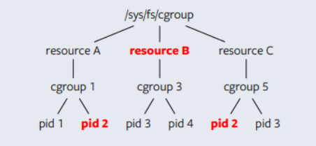
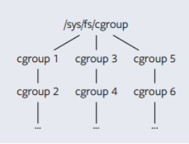
Control groups
Control group version 1
- Using only namespaces mentioned before what happens in case of an infinite loop?
- Control groups are made up of controllers that give user control over resources such as:
- Amount of I/O inputs
- Network priority
- Memory
- Amount of processes allowed at one time
- Cpu use
Cgroups commonly used today are called Cgroups v2 and are different from v1 – mainly in a strictly hierarchical structure of v1. V2 brings simplicity to hierarchies.
More about that in my report.
Control group version 2

Slide 9
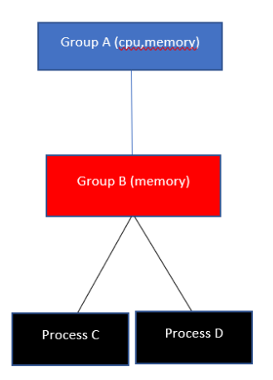
Cgroups version 2
Creating a new cgroup or subgroup is simple – simply creating a folder inside /sys/fc/cgroup
Subgroup cant override parent group
Only groups without subgroups can control actual processes
Sub group only has access to controllers parent group has
Unprivileged users can control processes via cgroups by simply being given ownership over a folder

Slide 10
Creating a basic container and short demo
I used Golang to develop a container. Reading and even writing the code doesn’t require deep knowledge of the language.
Goal of the container is to be able to run a shell that is somewhat separated from the rest of the host system.
Installing alpine distribution of linux – distribution that is very popular among all containerization platforms.

Slide 11
Comparison to known platforms
When looking it as a complete package – it would be very hard to find application where my implementation of containerization would even be preferable to big and famous ones.
Strength of understanding the building blocks of such technologies and being able to use them on wide range of processes comes when quick fix for an application is needed or when only small customizations are needed.
Especially for legacy code that was not developed with containers in mind – we can add limitations that don’t interfere with intended workings of that application while straying from more invasive ones (network namespace).

